Slide 1
South Carolina
Sales Territory
EMPORIUM · CAPSTONE 1
Four years of in-store and online sales analysis
Brandon Silverio
South Region
Jan 2022 – Dec 2025
Notes:
Hi, I'm Brandon. I was assigned the South Carolina sales territory for EmporiUm, the student bookstore chain. I looked at both the in-store and the online side of that territory across four years of data. For each of the manager's questions I'll show how I got the answer before I show the answer, and I'll finish with a recommendation for next quarter.

Slide 2
How I worked
01
Profiled the schema before writing anything — SHOW TABLES, DESCRIBE on all eight, and sample rows, because column names alone don't tell you what's inside them.
02
Searched for 'SC' and got zero rows. States are stored as full names, so the real filter is 'South Carolina'. An empty result looks like an answer but is usually a typo.
03
Found South Carolina in both store_locations and online_sales, so I answered every question twice rather than guessing which channel the territory meant.
04
Wrote each question as a comment, the query under it, and the answer under that — so the script reads as a document.
05
Checked anything surprising against the other channel before believing it. That habit is what produced the finding this whole analysis turns on.
Notes:
Before the answers, here's how I worked. First I profiled the schema — SHOW TABLES, DESCRIBE on all eight tables, sample rows. Column names don't tell you what's actually in them. Second, I searched for SC and got nothing back, which is worth calling out, because an empty result looks like an answer but it's usually a typo. The states are stored as full names. Third, once I searched properly, South Carolina turned up in both the store table and the online table, so instead of guessing which one my territory meant I answered every question twice. Fourth, the script is laid out as question, query, answer, so it reads as a document. And fifth, anything surprising I checked against the other channel before I believed it — that's the habit that found the thing this whole analysis turns on.

Slide 3
South Carolina runs two channels, not one
IN-STORE
ONLINE
Two stores
Shipped to SC
Charleston and Greenville. 4,472 transactions over four years.
1,231 transactions over the same four years.
THE FIVE TABLES I NEEDED
online_sales and store_sales hold the transactions · store_locations ties a store to a state · management ties a territory to its region · products and inventory_categories turn a product number into a category name
sample_sales database · 8 tables, 5 used
Notes:
Here's what the territory actually is. Two physical stores, Charleston and Greenville, about 4,500 transactions between them. And online orders shipped into South Carolina, about 1,200 transactions. Of the eight tables I needed five. The two sales tables hold the transactions themselves. store_locations is what tells me which store sits in which state. management tells me which region a state belongs to. And products plus inventory_categories is the chain that turns a product number into a readable category name. Those three lookup tables are the reason almost every query has a join in it.

Slide 4
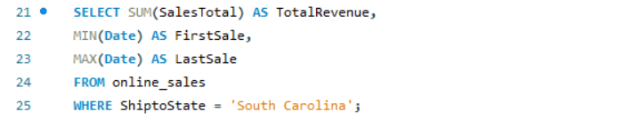
Three numbers, one pass over the table
QUESTION 1 · HOW
WHY ONE QUERY
All three answers are aggregates over the same filtered rows, so there's no reason to scan the table three times.
WHY NO JOIN
ShiptoState sits directly on online_sales. The in-store version needs a join, because store_sales only knows a store number.
MIN and MAX on a date column give you the earliest and latest
Notes:
Question one wanted total revenue plus the period the data covers. That's three numbers, and all three are aggregates over the same set of rows, so I did it in one query rather than three. SUM for the revenue, and MIN and MAX on the date column, which on dates give you the earliest and the latest. No join needed here because the state is sitting right on the online_sales table. The in-store version of this same query does need a join, because store_sales only knows a store number, not a state.

Slide 5
$1.37M in total revenue, split almost evenly
QUESTION 1 · ANSWER
ONLINE
IN-STORE
PERIOD COVERED
$719,989
$648,813
Jan 2022 –
Dec 2025
52.6% of SC revenue
47.4% of SC revenue
Four full years
The two channels are close to even on revenue. Everything interesting is in how they get there.
Grand total $1,368,801.31
Notes:
Online is 719,989. In-store is 648,813. About 1.37 million combined and close to an even split, and both channels run the full four years. If I stopped at this slide I'd tell you the two channels are equally healthy. They're not, and the next question is where that falls apart.

Slide 6
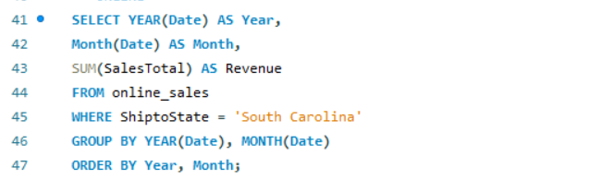
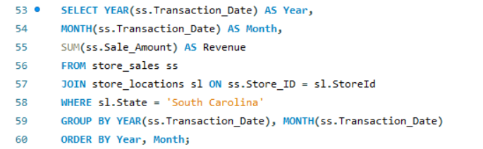
Grouping on a function, not a column
QUESTION 2 · HOW
THE TRICK
There is no Year column. YEAR() and MONTH() pull the parts out of a date, and you group on the function itself.
BOTH, OR NEITHER
Group by month alone and all 4 get merged in a row. The year is needed as well.
Online Sales returned 43 rows, not 48. Five months produced no row at all, which means no sales whatsoever — and that is what sent me to check the other channel.
4 years × 12 months = 48 expected
Notes:
Question two wanted the breakdown by year and month. The trick here is that there is no Year column in the table — YEAR and MONTH are functions that pull those pieces out of a date, and you group on the function itself. You need both: group by month alone and January 2022 merges into January 2023. Now, the important part. This query came back with 43 rows when four years of months should be 48. A missing row doesn't mean a zero, it means there was no transaction at all in that month. Five dead months. That's the thing that made me go look at the in-store side, and everything good in this analysis came out of that.

Slide 7
One channel is steady. The other is the opposite.
QUESTION 2 · ANSWER
Online
In-store
Only 43 of 48 months had any sales
Five months carry 79% of revenue
The quiet months fall under $1,000
Sales in all 48 months, no gaps
Every month between $5K and $35K
Growing year over year, best in 2025
Same state, same four years, nearly the same revenue. Two completely different businesses.
43 rows online · 48 rows in-store
Notes:
And here's the split. Online has sales in 43 of 48 months, and five of those months carry 79 percent of its revenue — the rest are often under a thousand dollars. In-store has every month covered, in a tight band, growing year over year with 2025 the strongest. Same state, same period, nearly identical totals, and they behave nothing alike. That contrast is the real finding of this project.

Slide 8
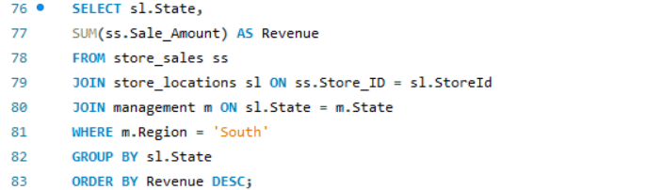
Getting from a store to a region takes two hops
QUESTION 3 · HOW
THE PROBLEM
A sale knows its store number. It does not know its state, and it certainly does not know its region.
THE FIX
Join to store_locations for the state, then join again to management for the region. Only then can WHERE filter on it.
ONLINE IS SHORTER
One hop — online_sales already carries the state, so it joins straight to management.
store_sales → store_locations → management
Notes:
Question three compares the territory with its region, and this is the query I'd point at if someone asked me to show my SQL. The problem is that a row in store_sales knows its store number and nothing else. It doesn't know what state it's in and it definitely doesn't know the region. So I join to store_locations, which gets me the state, then join again to management, which gets me the region. Only after those two hops can the WHERE clause filter on South. The online version of this is one hop shorter because online_sales already carries the state on it.

Slide 9
SC is the smallest territory in the South, both ways
QUESTION 3 · ANSWER
ONLINE
IN-STORE
State | Revenue | Share
Texas | $4,790,461 | 62.7%
Florida | $2,130,043 | 27.9%
South Carolina | $719,989 | 9.4%
State | Revenue | Share
Florida | $3,930,188 | 49.1%
Texas | $3,417,850 | 42.7%
South Carolina | $648,813 | 8.1%
Around 8–9% of the region in both channels. SC is a small territory overall, not a territory that is weak in one channel.
South region · Regional Director Andy Gisselquist · Sales Manager Len Jensen
Notes:
South Carolina sits in the South with Texas and Florida. Online, SC is about nine percent of the region. In-store, about eight. Third either way. That's worth stating plainly, because it means SC isn't underperforming in one channel specifically — it's simply a smaller territory than Texas or Florida. Notice Texas and Florida swap places between the two channels. SC doesn't move.

Slide 10
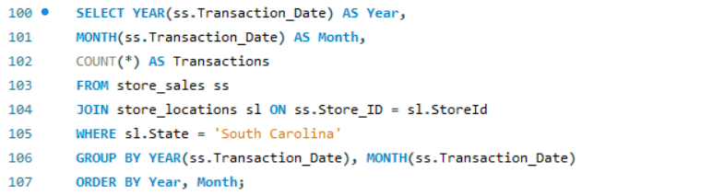
Counting and averaging in the same pass
QUESTION 4 · HOW
TWO HOPS AGAIN
A sale has a product number, a product has a category id, and only inventory_categories has the readable name.
COUNT AND AVG TOGETHER
Both aggregate the same group, so one GROUP BY gives the volume and the value side by side.
ROUND
AVG returns four decimals. Money gets two.
online_sales → products → inventory_categories
Notes:
Question four wanted transactions and average transaction by category, so I needed two hops again. A sale carries a product number, the products table turns that into a category id, and only inventory_categories has the readable name. Then COUNT and AVG in the same query, because they aggregate the same group — that gets me volume and value side by side instead of running two queries and lining them up by hand. ROUND is there because AVG comes back with four decimals and money gets two. I ran this same shape against the store side too, and comparing the two is where the answer comes from.

Slide 11
Technology is worth four times more online
QUESTION 4 · ANSWER
Category | Online txns | Online avg | Store txns | Store avg
Technology & Accessories | 252 | $2,036.15 | 977 | $483.23
Textbooks | 126 | $751.97 | 588 | $175.58
Books (General) | 294 | $172.10 | 345 | $28.43
Apparel and Merchandise | 170 | $159.15 | 907 | $33.53
Art Supplies | 153 | $132.84 | 749 | $32.17
Stationery and Supplies | 236 | $59.97 | 906 | $10.08
Technology is roughly 71% of all online revenue on its own, off only 252 transactions. Books has more online orders and a tenth of the value.
Sorted by online average transaction
Notes:
The headline is the top row. Technology and Accessories averages just over two thousand dollars a transaction online, more than four times the 483 it averages in store. And on only 252 transactions it accounts for roughly 71 percent of all online revenue. Compare that with Books, which actually has more online orders — 294 — but averages 172 dollars. So online isn't a smaller version of the store. People buy different things through it, and they buy the expensive things.

Slide 12
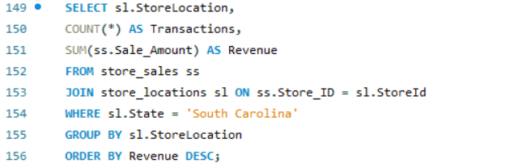
Picking the version of the question that has an answer
QUESTION 5 · HOW
THE CHOICE
Rank the stores in an in-store territory or rank the states in an online one.
WHY STORES
South Carolina is one state. Ranking states would return a single row — a ranking of one is not a ranking. Store ranking in the state bring back a more accurate answer.
COUNT ALONGSIDE
Revenue alone can't tell a busy store from an expensive one. COUNT separates the two.
GROUP BY the store, ORDER BY the revenue
Notes:
Question five gives you a choice — rank the stores if you have an in-store territory, or rank the states if you have an online one. South Carolina is a single state, so the state version would come back as one row, and a ranking of one thing isn't a ranking. So I ranked the two stores. I pulled COUNT next to the revenue on purpose, because revenue by itself can't tell you whether a store is busy or just expensive, and here that distinction turned out to matter.

Slide 13
Greenville edges Charleston by 8%
QUESTION 5 · ANSWER
1 · GREENVILLE
2 · CHARLESTON
$337,002
$311,811
2,297 transactions · $146.71 average
2,175 transactions · $143.36 average
A $25K gap on 122 more transactions, and the average sale is within three dollars. There is no weak store to fix here.
Two stores · both open the full four years
Notes:
Greenville first at 337 thousand, Charleston second at 312. That's an eight percent gap on 122 more transactions, and the average sale is within three dollars of each other. Practically speaking the two stores perform the same. There's no underperforming store to go fix, which is part of why my recommendation points somewhere else.

Slide 14
January and April drive 73% of online revenue
Online
In-store
Jan
Feb
Mar
Apr
May
Jun
Jul
Aug
Sep
Oct
Nov
Dec
April alone does $319,805 against July's $2,028. In-store never leaves the $41K–$67K band all year.
All four years combined, grouped by month of year · both channels on the same scale
Notes:
This is the chart I built in Excel, redrawn with both channels on the same scale, which is the part Excel wasn't showing me. Grey is in-store, blue is online. In-store is a flat band all year, 41 to 67 thousand a month, every month. Online is two towers and ten stumps. April does 319 thousand dollars. July does two thousand. January and April together are 73 percent of all online revenue for the territory. For a student bookstore that lines up with the academic calendar, which means those quiet summer months aren't a broken channel — they're the off-season. And I only found this because the missing months in question two looked odd enough to check against the other channel.

Slide 15
Put Q1 behind online Technology, timed ahead of January
RECOMMENDATION
The timing is already right
The category is already clear
The demand is already there
Next quarter contains January — 298 online orders and $207K, the second-biggest month of the year.
Technology averages $2,036 online against $483 in store, and carries 71% of online revenue.
The spikes are hundreds of separate customers, not one bulk buyer. 536 orders in April.
THE TRADEOFF
In-store is the safer channel — every month covered, growing year over year. Online only pays off twice a year. But Q1 is one of those two windows, so the timing carries it.
Measure: online Technology orders in January against this year's 298
Notes:
So, the recommendation. Focus Q1 on the online channel, specifically Technology and Accessories, with the spend landing before January rather than during it. Three reasons. First the timing — next quarter contains January, already the second-biggest online month. Second the category — Technology averages two thousand dollars online against 483 in store. Third, the demand is real: those spikes are hundreds of individual customers, not one institutional order, and I checked that specifically by pulling transaction counts alongside revenue. The honest tradeoff is that in-store is the safer bet. It never has a bad month and it's growing. Online is dead eight months of the year. But next quarter is one of the two live windows, so the timing makes the case. And the thing to measure is online Technology orders in January against this year's 298.

